Slide 1


National Federation of Federal Employees Local 476
(NFFE476)
New Employee Briefing
29 March 2021
Local 476

Slide 2

Federal Civil Servants are Special
Oath to support and defend the US Constitution
Jobs are driven by legal and moral values
  Systematically determined by the US as a whole.
  Not driven by profit.
  Businesses try to maximize profit within legal bounds
  Federal workers try to maximize the law enforcement within available funds.
Congress established a system of protections
  Practical alternatives to the spoils system
  Unions specifically endorsed by law
  Federal Labor Relations Authority (FLRA) – Establish Unions/Col Bargaining
  Merit System Protections Board – Protection against favoritism/abuse
  Equal Employment Opportunity (EEO) – Prevention against discrimination
  Legally prevented from striking
Local 476

Slide 3

Management’s Role
According to 5USC§7106, it is Management’s job to determine the agency’s
mission
budget
organization
number of employees
internal security practices
and, with regarding to employees, to
hire
assign
direct
layoff
discipline (suspend, remove, reduce in grade or pay, for example)
assign work
contract out
Local 476

Slide 4

Union’s Role
Peaceably assemble, and to petition the Government
  Address grievances.” [US Constitution, 1st Amendment]
Congress believes that “labor organizations and collective bargaining in the civil service are in the public interest.” [5USC7101]
Unions bargain with Management over
  Procedures which management will observe
  Appropriate arrangements for employees adversely affected by Management
  Agency Discussions
    the numbers, types, and grades of employees or positions assigned to any organizational subdivision, work project, or tour of duty
    the technology, methods, and means of performing work
Local 476

Slide 5

Your Rights
Weingarten Rights - Garrity and Kalkines Warnings
  "If this discussion could in any way lead to my being disciplined or terminated, or affect my personal working conditions,
  I respectfully request that my union representative, officer, or steward be present at this meeting. Until my representative arrives, I choose not to participate in this discussion."
  NOTE: Management is NOT required to advise an employee of the right to Union representation
Garrity Warning: You are being asked to provide information as part of an internal and/or administrative investigation.
    This is a voluntary interview and you do not have to answer questions if your answers would tend to implicate you in a crime.
    No disciplinary action will be taken against you solely for refusing to answer questions.
      However, the evidentiary value of your silence may be considered in administrative proceedings as part of the facts surrounding your case.
    Any statement you do choose to provide may be used as evidence in criminal and/or administrative proceedings.
  Kalkines Warning: You are being questioned as part of an internal and/or administrative investigation.
    You will be asked a number of specific questions concerning your official duties, and you must answer these questions to the best of your ability. Failure to answer completely and truthfully may result in disciplinary action, including dismissal.
    Your answers and any information derived from them may be used against you in administrative proceedings.
      However, neither your answers nor any information derived from them may be used against you in criminal proceedings, except if you knowingly and willfully make false statements.
Local 476

Slide 6
What is NFFE476?
Your local labor union organization for professional employees
Affiliated with the AFL-CIO
We are CERDEC or CECOM employees, just like you
We are your exclusive representative to Management
We spend our own time and some duty time
  Reviewing policies and procedures before they are implemented
  Proposing improvements and negotiating compromises
  Meeting with Management and advocating for employee concerns
  Handling individual and collective employee grievances
  Sharing workplace stories
Our organization allows the work of a few people to benefit everyone. This is known as “Collective Bargaining”.
Local 476

Slide 7
Union Organization https://nffe.org
  National Federation of Federal Employees: is an American labor union which represents about 100,000 public employees in the federal government. NFFE has about 200 local unions, most of them agency-wide bargaining units.
  Members: 100,000
  Office Location: Washington DC
  Founded: 17 September 1917
  Affiliations: International Association of Machinists and Aerospace Workers, AFL–CIO
Local 476

Slide 8
Who Does NFFE-476 Represent
  Professional Disciplines:
  Technical Pay Pool: 0801, 0803, 0830, 0850,0854, 0855, 0893, 0896, 1306, 1310, 1550
  Business Pay Pool: 0170, 0510, 0511, 0905, 1101, 1222, 1515
  Trainee Pay Pool: 0599, 0899, 1599
Local 476

Slide 9
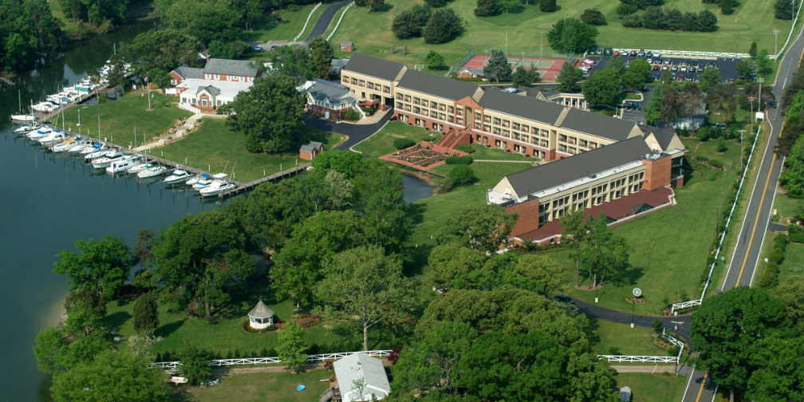
IAM/NFFE Benefits https://UnionPlus.org
  Free College
  Machinist (W3) Training Facility
  Scholarships
  Mortgage Refinancing
  Financial Counseling
  Auto Discounts
  Travel and Vacation Discounts
  Entertainment Discounts
  Geico Discounts
  Workers Compensation Legal Representation
  Supplemental Insurance Plans
  Disability Retirement
Local 476

Slide 10

What we are doing now https://nffe476.org
Collective Bargaining Agreement (CBA) Renegotiations?
  Rights and Obligations of the Union and Management
  Fair and Unfair Labor Practices
  Dispute Resolution
  Procedures for Furloughs, Reduction in Work Force,
  Telework
  Performance Ratings
  Safety and Health
  Alternate Work Schedule
Return to work plan
Telework
Pay Demo for CECOM & C5ISR Center MOA
Local 476

Slide 11
How to contact us
Visit our office in building 4313 (by appointment)
Email
  USARMY APG CECOM Mailbox NFFE LOCAL 476 <usarmy.apg.cecom.mbx.nffe-local-476@mail.mil>
  president@nffe476.org
Phone
  410-278-2456
Officers
  President: Michael Semenoro, E-mail: michael.Semenoro.civ@mail.mil
  Vice President: Thomas C. Angioletti
  Recording Secretary: TBA
  Secretary-Treasurer: Loring Hosley
  Conductor-Sentinel: Melrone McCray
Trustees
  Ken Buergin, Lyra Clark, Tracey Young
Auditing Committee
  Michael Devins, Roland Kopp, TBA
Local 476

Slide 12

How to get involved
NFFE Local 476 meets the third Wednesday every month, 1700-1800
Bldg 4313, Integrity Ct (Boothby Hill Rd, across from C4ISR Campus)
  Virtually via Uber Conference or other conference vehicle
Discuss new or on-going issues
  Improve working conditions
Form committees
  Support employee’s welfare and ensure fair treatment
  Educate the work force regarding their rights and benefits
  Plan events and network with other co-workers
  Support the warfighter and community
Free snacks and soft drinks
Local 476

